Slide 1
INTRODUCTION TO SOFTWARE ENGINEERING
Honie Cosmetics

Slide 2
ABOUT HONIE COSMETICS
The Honie Cosmetics shop will enable customer to buy for product on-line. The Honies Cosmetics shop allows Store owner to put their product on system and to maintain a record of your buying and selling on a regular schedule.

Slide 3
THE CONTENT INCLUDES
01
02
PROBLEM
PROJECT MANAGEMENT
Problem statement, product position statement, users/market.
Team structure and responsibilities of team members.
03
04
SOFTWARE REQUIREMENTS
ANALYSIS AND DESIGN
Use-case model, non-functional requirements.
Architecture and technologies used.
05
SOFTWARE TESTING
06
DEMO
Test environments, test plan, and test results.
Demo a key scenario of the software.

Slide 4
PROBLEM STATEMENT
THE PROBLEM OF
It is difficult for customers to access the product in during covid-19 and advertisements
AFFECT
Customer, shop owner.
THE IMPACT OF WHICH IS
Leads to customers difficulty in finding products and reduced customer reach. The store's sales decrease. That's the reason why many stores have to close.
A SUCCESSFUL SOLUTION WOULD BE
Build a website: Customers will have an easier way accessing the store's products and advertisements. Improve service quality: There are pictures for customers to see and evaluate. Reliable: Friendly interface, 24/7, the invoice can be issued

Slide 5
PRODUCT POSITION STATEMENT
FOR | Shop owner and customers
WHO | Seller ​​and buyer genuine cosmetics
THE PRODUCTS NAME |  | Honie Cosmectics
THAT
Traditional way of buying. Customers have to go to the store to see the products and order directly.
UNLIKE
Traditional way of buying, inconvenient compared to the traditional way of buying and selling.
OUR PRODUCT
Connects stores and customers and ensures trust between them by rigorously verifying their identities. Customer easily search product, order online, purchase order lookup and contact with store 24/7. Stores easily manage sales revenue, update products and promotions. Provides users with details about the cosmetics like price, rate and number of products that are available also Honie Cosmetics going to be a more known cause of good rating.

Slide 6
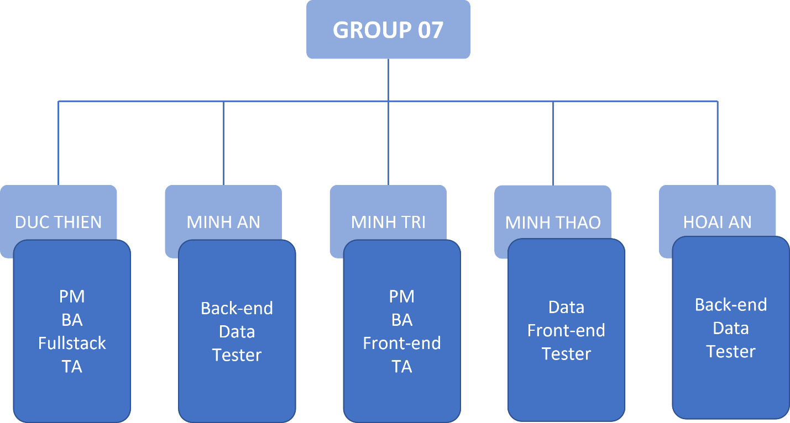
PROJECT MANAGEMENT
Team structure

Slide 7
RESPONSIBILITIES OF TEAM MEMBERS
NV MINH TRI
N HOAI AN
HH MINH AN
Assign appropriate tasks to each member to test the project before handing over and use the flow effectively
Complete assigned tasks, ensure database connection
Complete assigned tasks, ensure database connection
T DUC THIEN
NT MINH THAO
Complete assigned tasks, handle processes efficiently
Complete assigned tasks, Easy to use interface design

Slide 8
—USE-CASE MODEL
SOFTWARE REQUIREMENT

Slide 9
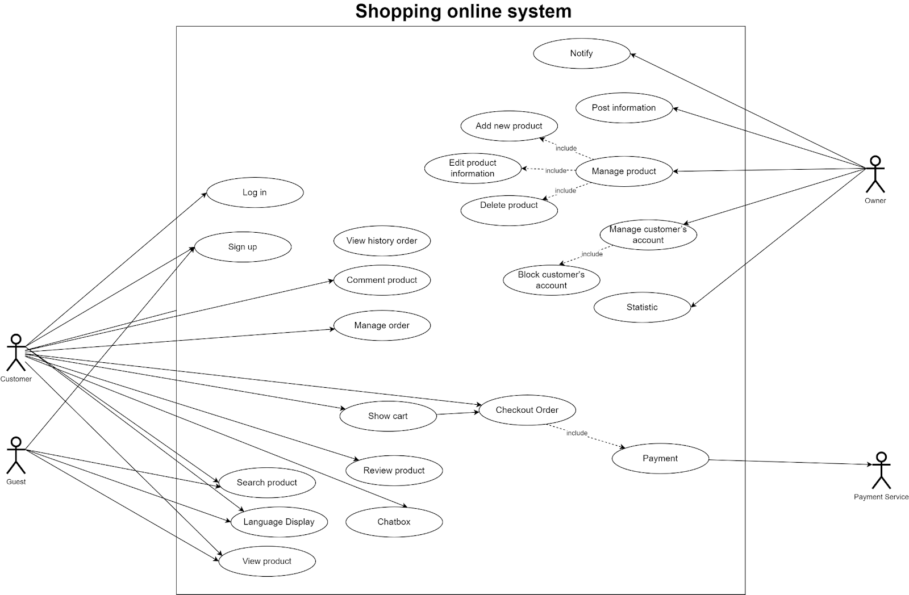

Slide 10

NON-FUNCTIONAL REQUIREMENT
Good looking interface:
A user-friendly interface will make it more attractive. They are easy to use and find the products they need
There are positive reviews from customers during use
Response speed:
Response time refers to the speed at which the server can respond to a request from the client. For example: Search for a product, Look up information,...
Quick page load time.
Security:
Customer Information: This is information that must be specially protected. If customer information is leaked, many people will use it to do negative things to customers
Store revenue: The store's revenue when leaked will affect the store's brand and the bad thoughts of customers.
Appropriate language: Check for inappropriate words: swear words, racism, political issues, spam,...

Slide 11
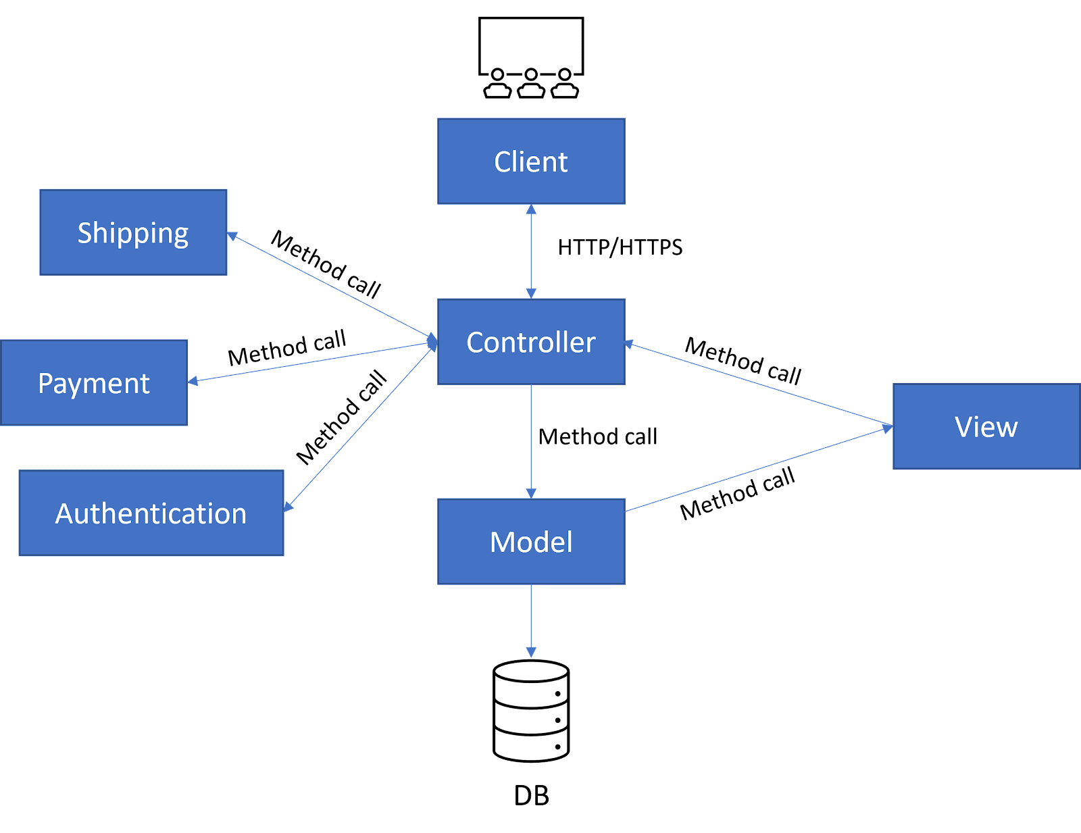
ANALYSIS AND DESIGN
Model-View-Controller Pattern

Slide 12
TECHNOLOGY USED
BACK-END
FRONT-END
NodeJS/ExpressJS
MVC Model
Bootstrap
Jquery
HTML
CSS
Javascript
Handlebars

Slide 13
SOFTWARE TESTING
OPERATING SYSTEM
Enviroment
Internet Browser
MySQL
->The database management system from Oracle will be store data and make it easier to locate the data you need
NodeJs
->This is a cross-platform, open-source server environment that can run on Windows, Linux, MacOS,.. This is a web-end JavaScript runtime runtime environment.
Windows 10, 64 bit
Windows 11, 64 bit
Mac OS X 10.10
->The operating system will be the software that manages the software and hardware needed for testing
Google
MS Edge
->To display a software interface that allows user interaction with the system for testing
IDE
Visual Studio Code
->To run the backend and frontend source code of the system for testing
eMail Client software
MS Outlook

Slide 14
TEST PLAN
TESTING METHOD
Hardware Requirement
List Software Items
People and Roles
Functional Testing
Usability Testing
Laptop or PC with CPU of Intel or AMD series
Laptop or PC with at least 4GB RAM and need more than 50GB hard drive.
1.5 GB of free disk space for installation, plus extra space for temporary files during test runs (see below)
TEST PLAN
Login
Signup
Filter
Edit profile
Edit password
Product detail
Update cart
Checkout
Test manager: NVMTri
Tester: All members
Test System Administrator: HHMAn,TDTHien

Slide 15
TEST RESULT
USE-CASE Tested
Bug Report
Later
Number: 09 use-case
37 case tested
17 case Failed
20 case Pass
Tester: NVMTri, NTMThao, TDThien, NHAn
09 Bug found
03 Bug Open
06 Bug Closed
Bug Report: NHAn
Also added some new functions and tests that have not been recorded in test cases as well as bug reports

Slide 16
THANKS!
Do you have any questions?
nhan@gmail.com
+84 342 389 598
Please keep this slide for attribution

